Slide 1
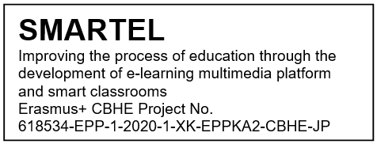
SMARTEL Presentation of e-learning system at UPM
Workshop on digital learning technologies and case studies
27-28th April 2021
Slobodan Bojanic
Universidad Politécnica de Madrid (UPM)
Spain

Slide 2
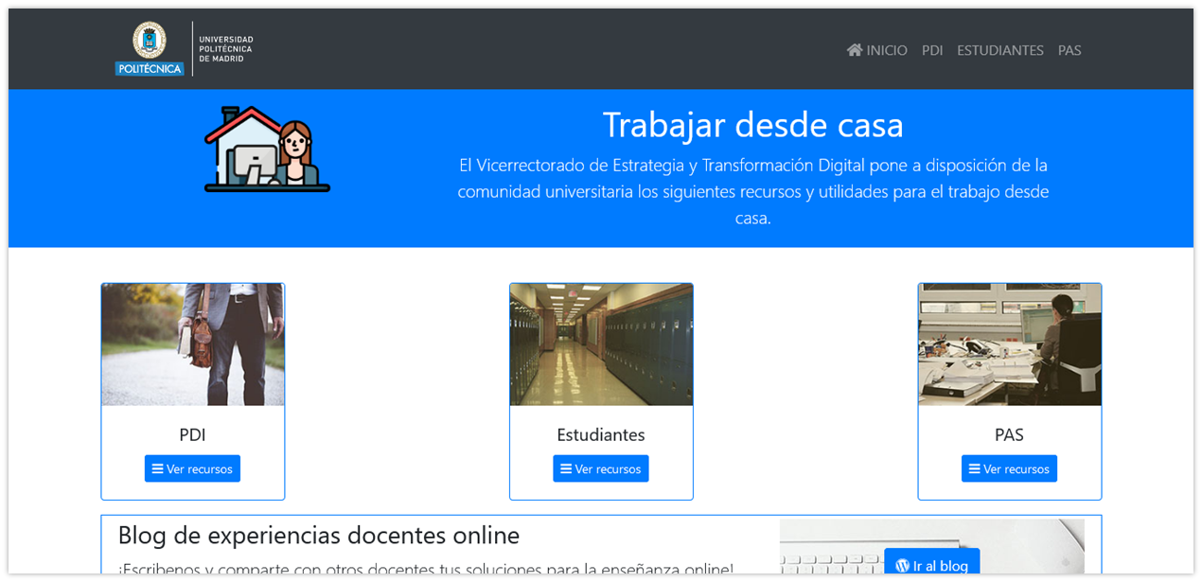
Resources for working online at UPM
Teachers
Administrative staff
Students

Slide 3
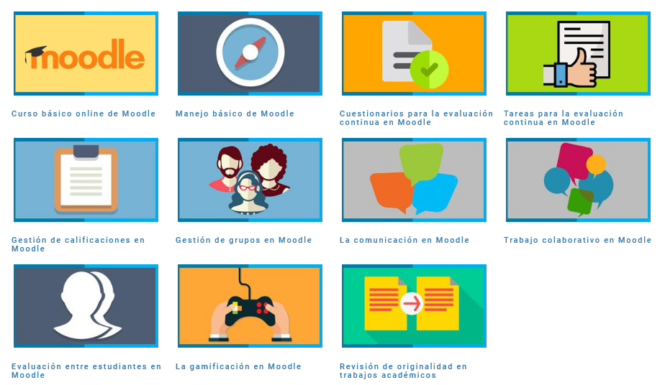
Courses for online teaching at UPM
Online basic Moodle course
Basic Moodle use
Questionnaires for continuous evaluation on Moodle
Notes management on Moodle
Groups management on Moodle
Communication on Moodle
Colaborative work on Moodle
Student evaluation on Moodle
Gamification on Moodle
Originality check of academic works

Slide 4
Resources for online teaching at UPM
Webinar about Turnitin (verification of originality) and Interpretation of originality informs.
Webinars about
Moodle 3.9, basic Moodle, tasks in Moodle, Questionnaires in Moodle, Fora in Moodle, Management of groups in Moodle, Gamification guide for Moodle, Storing big files on Moodle.
How to
create new course on Moodle
send message to students
configure an access key for the course
add a video from YouTube to our Moodle
add a post from Facebook to our Moodle
synchronize Google calendar with that of Moodle
Introductory guide for Institutional Platform for online teaching, for professors and for students.
Opening a questioners for one or more students.
Use of PDF editor for students.

Slide 5
Online evaluation at UPM
Guides and video tutorials for online evaluation
identification, visualization, orals exams, students’ queries data protection,
warnings about identification of students on online evaluation tests, prohibition of recording exams,
data protection, honesty code.
Microsoft Teams guides and video tutorials
for online evaluation tests and their revisions of online evaluation tests,
attending students’ queries on online exams on private chat,
oral tests and attending students queries oral exams,
photographing exams with Microsoft Lens.
Zoom guides
for online evaluation tests, identification of students online evaluation, oral exams
attending students’ queries during online evaluation tests,
visualization during online evaluation test.
Blackboard Collaborate online exam
identification and visualization of students, oral exam, attending students’ queries,
user guides for online test and revisions.

Slide 6
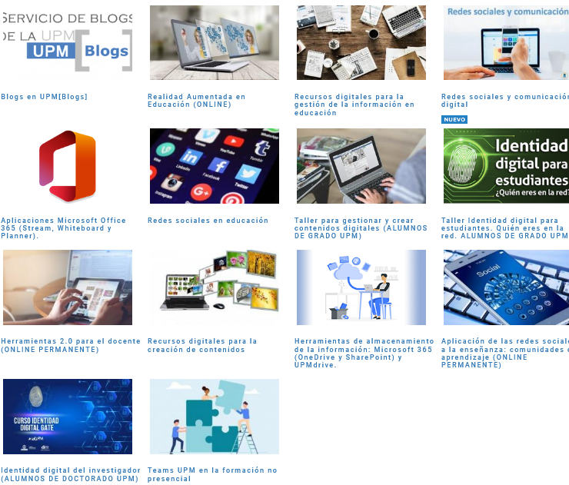
Courses and resources at UPM for ICT in education
Blogs at UPM
Augmented reality in education
Digital resources for information management in education
Gamification
Alternative credentials (digital badges)
Mooc
Social networks and digital communication
Social networks in education
Mobile learning
ICT and education
Microsoft Office 365 applications (Stream, Whiteboard y Planner).

Slide 7
Resources for audio visual tools
Good practices for making audio from home
How to scan documents with mobile
Guide for programs for video capturing and edition
How to share a mobile or tablet on Skype
Presentation of the course for screeen recording with OBS
Presentation of the course for screeen recording with Camtasia (shareware)
How to capture easily the screen of my computer
Screencast and edition of video with mobile devices (for IOS)
Screencast and edition of video with mobile devices (for Android)
Capturing the desk top with XBOX Game Bar of Windows 10
Recording a Powerpoint presentation by video
Guide for using else’s audiovisual resources
Video tutorial and guide for recording proper educational videos
Three proposals how to edit video as a profesional

Slide 8
Videoconferencing resources at UPM
Video conferences using Microsoft Teams UPM
Norms about recording and use of virtual clase at UPM
How to give a lectures from home, material needed for a profesional video conference
Comparison of videoconference systems at UPM and at the market.
Useful tools for videoconferencing in group
Moodle, how to realize virtual lectura, how to realice video conference meetings external to Modle
Video tutorials about BlackBoard Collaborate
Installation of Office 365 (Skype Empresarial, Teams, SharePoint etc.)
Video tutorials about Teams, Stream UPM
Skype Empresarial video tutorials, guide, how to share a mobile or Tablet on Skype,
Zoom user’s guide, video tutorials, good practices, schematic guide for Zoom meetings, how to assist Zoom meeting, how to plan Zoom sessions for goverment bodies
Hangout user´s guide.

Slide 9
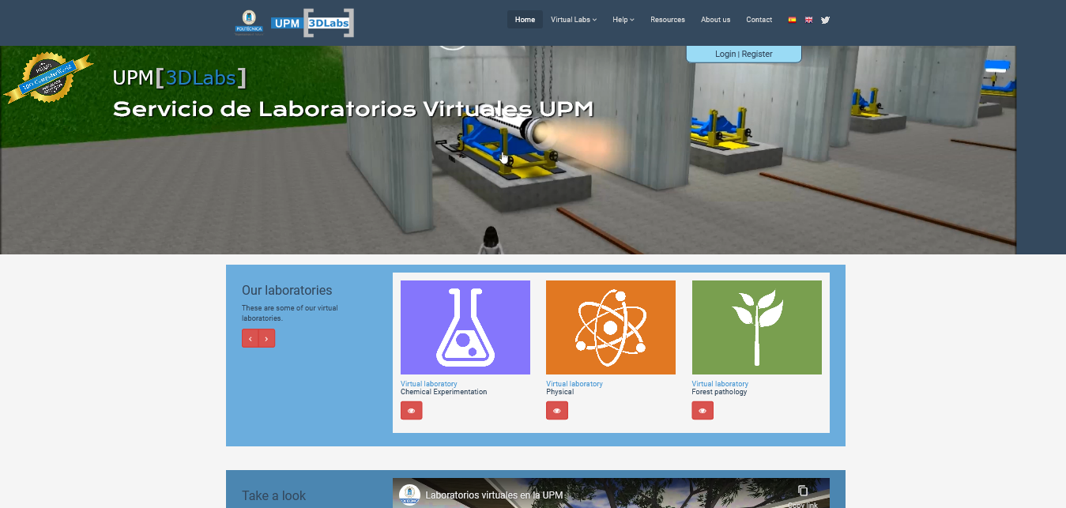
Virtual laboratories
General user´s manual, inside virtual worlds.
Technical manual of platform for developers of virtual worlds.
introduction to virtual laboratories,
creation of avatar
access configuration to laboratories
access to virtual worlds,
management of avatar and of camara.
Virtual Laboratories for shared use at UPM.

Slide 10
THANK YOU FOR YOUR ATTENTION

