Slide 1
Digital University Center presentation Unified Learning Environment
Marko Papić, University of Ljubljana
Ljubljana, 28th April 2021

Slide 2
Organization of digital learning and support
it is essential for the academic institution to provide organizational and user support as well as knowledge exchange to teachers about digital learning services provided
the institutional support consists of
raising awareness and training for teachers
providing pedagogical and technical support
maintenance and user support for digital learning platform
future R&D
communication with the management and other stakeholders;

Slide 3
Digital University Center (CDiUL)
separate organizational entity within the University of Ljubljana to support ICT use in the pedagogical process
pedagogy/didactics & technical support
organizing trainings, knowledge exchange among teachers, empowering teachers, engaging students
providing pedagogy and didactics support and consultations
enabling single, unified e-learning environment for UL members
research and development
five employees, engaging with all relevant University rectorate departments, UL members, Management, IT support, teachers…

Slide 4
Training and dissemination
webinars
online workshops
specific workshops
knowledge assessment using ICT
videoconferencing tools
LMS in the pedagogical process
interactive learning materials
innovative pedagogical methods and approaches
blended mode
DigCompEdu ICT pedagogical competencies
LMS in the pedagogical process
interactive learning materials
collaborative learning
formative assessment
learning analytics
live sessions
organized for the specific target groups of users (within the specific department or faculty)

Slide 5
Consultations
pedagogical:
recommendations – how to introduce digital into the learning process (DigCompEdu, UDL guidelines)
how to develop interactive digital materials
accessibility and inclusion of students (access to resources, activities, expectiations, limitations)
diferentiation and personalization
active inclusion of students (active and creative collaboration,indepth thinking, creatsive expressions...
video conferencing systems & LMS

Slide 6
Consultations
technical
multimedia equipment, cameras, microphones, additonal MM equipment
all technical online platforms
user support

Slide 7
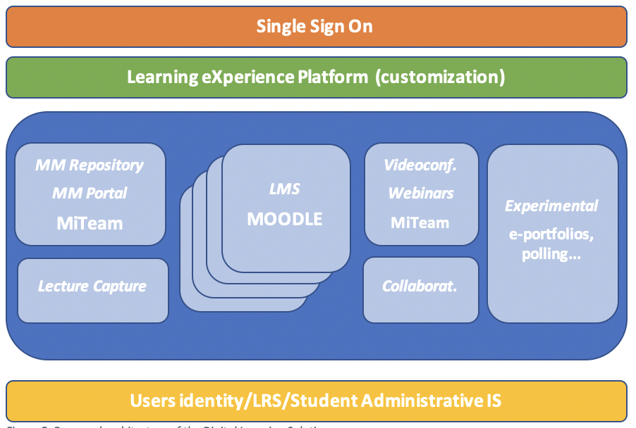
UL unified learning environment

Slide 8
Collaborative tools in the enviroment
INTERACTIVE PRESENTATIONS
COLLABORATIVE CREATIVITY
FORMATIVE ASSESSMENT

Slide 9
MM Repository and Lecture capture
MM Repository
piloting different solutions (MiTeam, Microsoft, MediaSite, AVideo)
content uploading; meta data; delivering content; administration; content management; user access rights; video player; interfaces (portal)
lecture capture
piloting different solutions (Caltura, Panopto, MiTeam)
automatized system from capturing to storing and delivering lectures

Slide 10
Other...
integration with student administrative system
LRS: Learning Record Store (learning analytics)
Single Sign On
common interface: web page for students and teachers to access all tools and content within the LXP

