Slide 1
University adriatik bar Faculty of traffic, communications and logistics
Presentation of D1.2 results

Slide 2
About ADRIATIK UNIVERSITY BAR
Adriatik University Bar has been founded in 2017 as Higher Education Institution with Mission to enable all students from Montenegro, West Balkans and World to acquire skills and knowledge nececary for their succesfull business carier.
University Adriatik Bar, has a mission to grow into a modern and prestigious institution of higher education, integrated into the common academic space of Europe and the world.
One of the main points of recognition of the University are the internal centers for practical training and coaching by University units. The estimated number of students is projected at around 3,000 and the teaching staff at around 250.

Slide 3
About ADRIATIK UNIVERSITY BAR
Adriatik University Bar consists of 8 Faculties
Faculty for maritime studies Bar, http://www.pfbar.me
Faculty for business economy and law Bar, www.fpebar.me
Faculty for business and tourism Budva, http://www.fbt-budva.com
Faculty for mediteranean business studies Tivat, http://www.fms-tivat.me
Faculty for menagement Herceg Novi, www.fm-hn.com
Faculty of mediteranean business studies Ulcinj, http://www.fms-ulcinj.me
Faculty of traffic, comunication and logistics Budva, http://www.fskl-cg.me/me
Faculty for international menagement in tourism and hospitality Budva, www.hecmontenegro.com

Slide 4
About ADRIATIK UNIVERSITY BAR
Faculty of traffic, communication and logistics has been authorised by Adriatik University Bar to conduct Erasmsus project SMARTEL

Slide 5
About Faculty of traffic, communications and logistics
The Faculty of Transport, Communications and Logistics, Budva is the only higher education institution in Montenegro, that deals with the education of engineers in the field of traffic, communication and logistics.
Mission of the Faculty of transport, Communications and Logistics is to develop, improve and spread knowledge, skills and abilities in the field of traffic, communication and logistics in compliance with European and global standards and in collaboration with appropriate educational and scientific institutions and companies from the region and even wider, all in accordance with the purpose and importance of traffic for future development.

Slide 6
About Faculty of traffic, communications and logistics
The main long-term goals for the realization of the Vision of the Faculty are:
Education of graduate engineers and postgraduates will be based on the latest knowledge (theory and practice) in the field of railway, road, air and postal traffic, e-communications and logistics
Become one of the prestigious regional institutions of higher education in the field of transport, communications and logistics
Fully apply modern educational and scientific technologies and encourages creativity
Education and scientific research strongly contributes to the optimal development of the transport system of Montenegro and its inclusion in the European and world transport system and the valorization of the comparative advantages of Montenegro.

Slide 7
About Faculty of traffic, communications and logistics

Slide 8
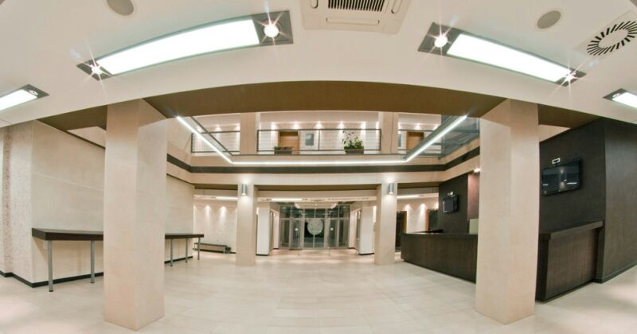
About Faculty of traffic, communications and logistics

Slide 9
About Faculty of traffic, communications and logistics

Slide 10
Project team - CORE
Phd Vujadin Vešović, full professor, dean - AUB coordinator
PhD. Nataša Gospić, full professor, AUB project manager
Mr. Marija Vuković, senior lecturer
Mr. Marko Asanović, teaching associate
Mr. Ivana Buzdovan, teaching associate
Miroslav Zečević, student

Slide 11
Results of d1.2 E-learning organization in Faculty of traffic, communication and logistics
E-Learning strategy is presented in several document, including annual Action Plan for the implementation of the Strategy for control and quality assurance of the Faculty;
Learning Management System „Moodle“ is implemented;
Prof. PhD. Nataša Gospić, as Vice-Dean for undergraduate and master studies is in charge of monitoring the implementation of e-Learning activities;

Slide 12
Results of d1.2 E-learning organization in Faculty of traffic, communication and logistics
Department of Electronic Communications as a unit is tasked to identify the goals and to improve e-learning by defining the methods of quality assurance and, controlling of e-teaching.
Task of maintaining the platform and providing technical access to platform for both teachesr and students is outsourced to external company.
Department of Electronic Communications is in charge of maintaining and improving the the platform, in term of modules and functionalities of the platform, as well as administrating the content.

Slide 13
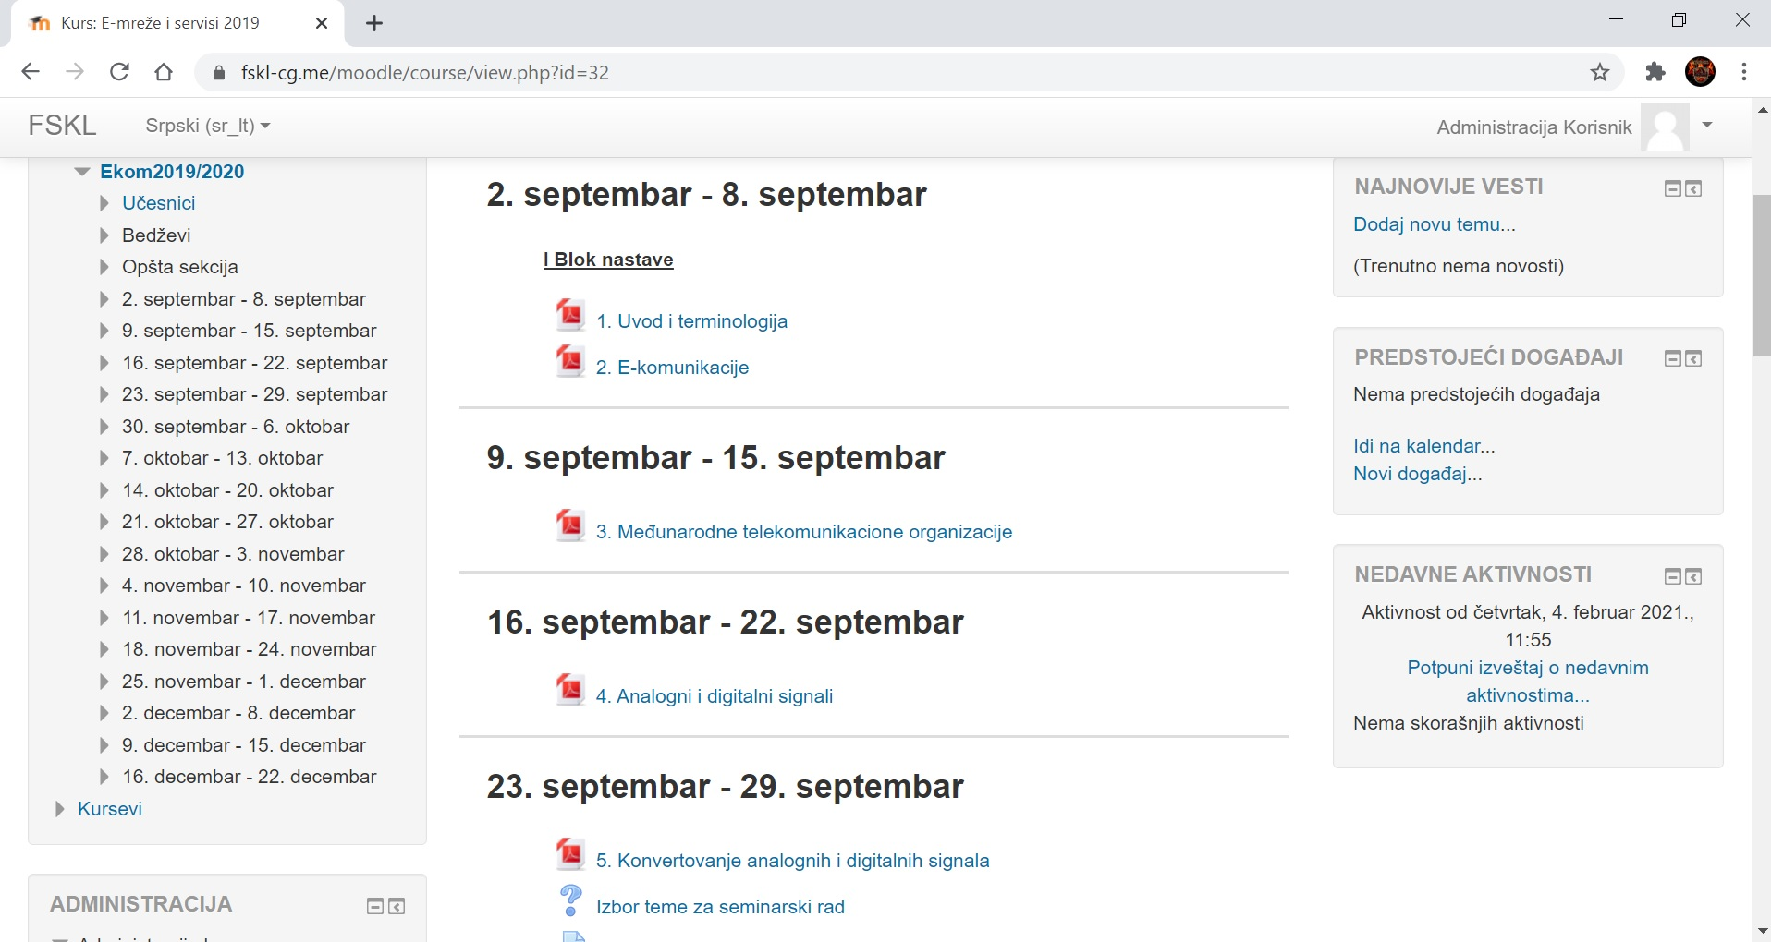
Results of d1.2 Learning Management Systems (LMS) in Faculty of traffic, communication and logistics
The Faculty for Traffic, Communications and Logistics, Budva uses the Moodle Learning Management System
The Moodle platform environment is designed in the form of a portal.

Slide 14
Results of d1.2 Learning Management Systems (LMS) in Faculty of traffic, communication and logistics
The security of the FSKL Moodle platform is the issue with very high level.
The user accesses the system via a username and password using any internet browser.
The privileges of the System themselves are determined by the user roles assigned to the participants.

Slide 15
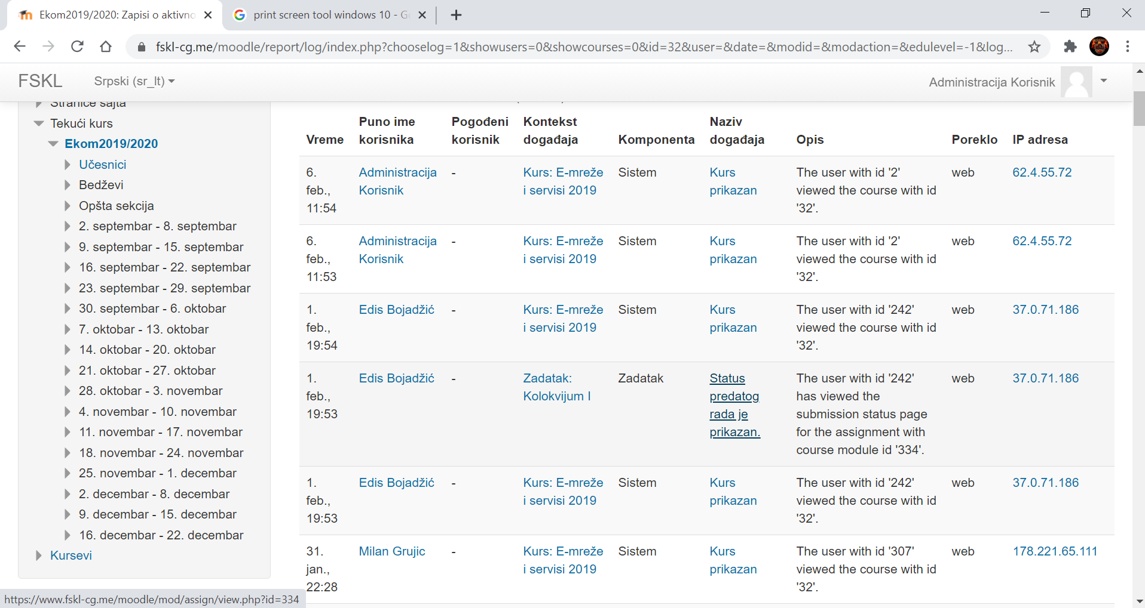
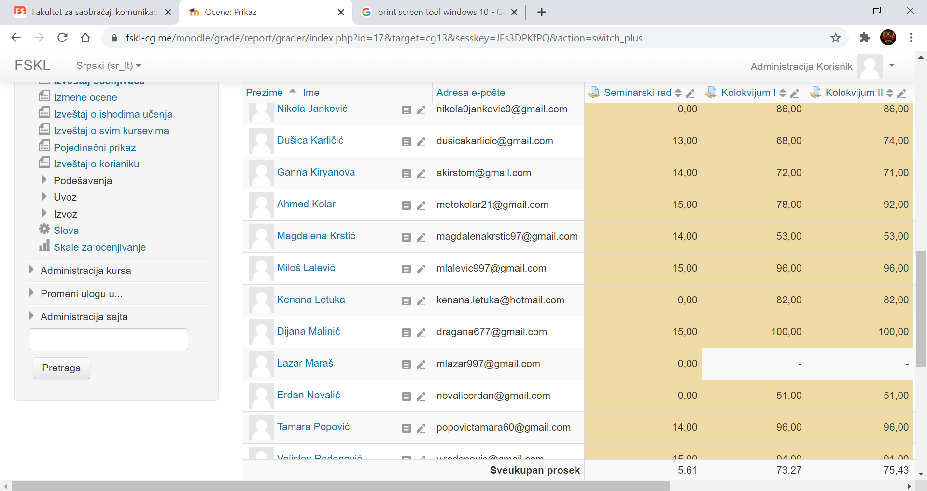
Results of d1.2 Learning Management Systems (LMS) in Faculty of traffic, communication and logistics
Reporting functionality is provided by the platform. It can generate reports on System access as well as results of the educational process.
The reports themselves can be exported in various formats.

Slide 16
Results of d1.2 Videoconferencing (remote or online lectures, laboratory work, auditoria work)
FSKL uses Zoom video conferencing software, the implementation of which has started mainly due to the overall situation with the Covid 19 virus.
FSKL began to explore the possibility of connecting the Zoom system with applied Moodle platform and video conferencing tools to automate these activities.
FSKL plan is to provide the necessary conditions for conducting e-lectures from the Faculty building, with the possibility of a hybrid way lecturing.

Slide 17
Results of d1.2 Colaborative platforms
FSKL uses Google drive to share e-learning materials, which are significantly large and are not able to be supported the by Moodle system.
Moodle allows the installation of large files, but this restriction primarily comes from the host server side, where FSKL is limited by the space on the server where the Moodle platform is located.

Slide 18
Results of d1.2 Exams and Knowledge assessment platforms, proctoring systems
In accordance with the Law on Higher Education, exams can be performed only within the Faculty premises;
Minor knowledge tests are performed through tests and quizzes that exist within the subject are done using Moodle platform;
FSKL team continually works on further increase the security of this type of testing, so the integration of Safe Exam Browser with the learning support system is in considering to be used.

Slide 19
Results of d1.2 Multimedia learning material storage (repository)
The Faculty for Traffic, Communications and Logistics does not currently produce video material for e-learning.
Recording lectures and producing video material is in the Action plan of the Faculty in the up coming period.

Slide 20
Results of d1.2 E-learning, online learning accredited study programs
The Faculty for Traffic, Communications and Logistics is currently not accredited to conduct distance learning.
The final goal of the Faculty is to be accredited for these study programs when all the beforementioned conditions are met.
The first condition is digital-multimedia classroom from where lecturers will be able to produce video material, or to hold lectures at a distance

Slide 21
Results of d1.2 E-learning enhancements for the students with disabilities
FSKL does not currently have material that would be suitable for students with hearing impairments, or the visually impaired
There are no requirements or documents that oblige the Faculty to make e-learning platforms suitable for people with these types of disabilities
Mission of FSKL is to make knowledge available to everyone, so creating such material is one of the future tasks of our institution.

Slide 22
THANK YOU FOR YOUR ATTENTION

