Slide 1
Project website and project management platform presentation
Petar Milić
University of Priština – Kosovska Mitrovica – UPKM
Kick-off meeting ... Kosovska Mitrovica ... 08th of February, 2021
This project has been funded with support from the European Commission. This publication reflects the views only of the author, and the Commission cannot be held responsible for any use which may be made of the information contained therein.
Improving the process of education through the development of e-learning multimedia platform and smart classrooms
Project number 618534-EPP-1-2O2O-1-XK-EPPKA2-CBHE-JP

Slide 2
TWO TOPCIS TO PRESENT
SMARTEL PROJECT WEBSITE
PROJECT MANAGEMENT PLATFORM

Slide 3
WWW.SMARTEL.PR.AC.RS
to create A PUBLIC
IDENTITY
to offer up-to-date
INFORMATION
to establish public
COMMUNICATION

Slide 4
WWW.SMARTEL.PR.AC.RS
WEB BANNERS linking
SMARTEL PROJECT WEBSITE
to be put on the CONSORTIUM
MEMBERS’ WEBSITES

Slide 5
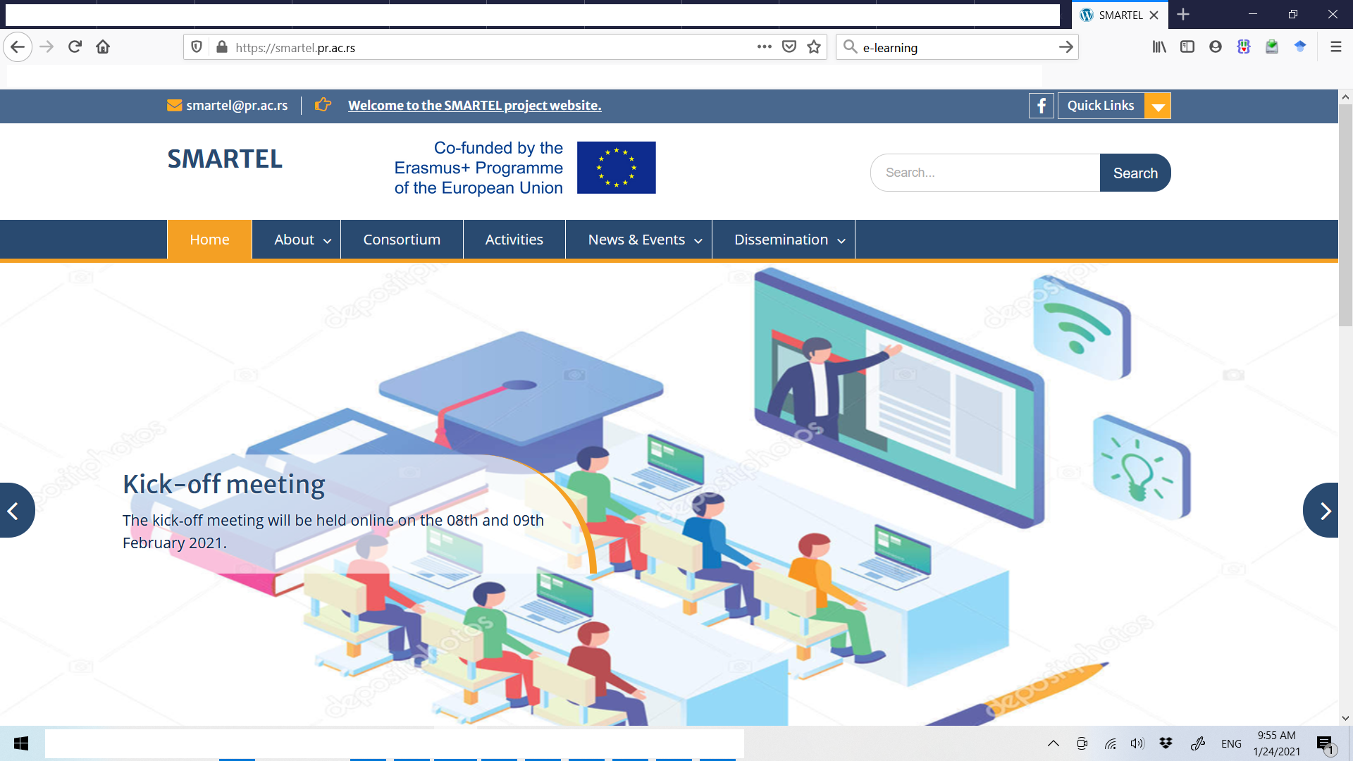
WWW.SMARTEL.PR.AC.RS
Important flash news
the main menu bar

Slide 6
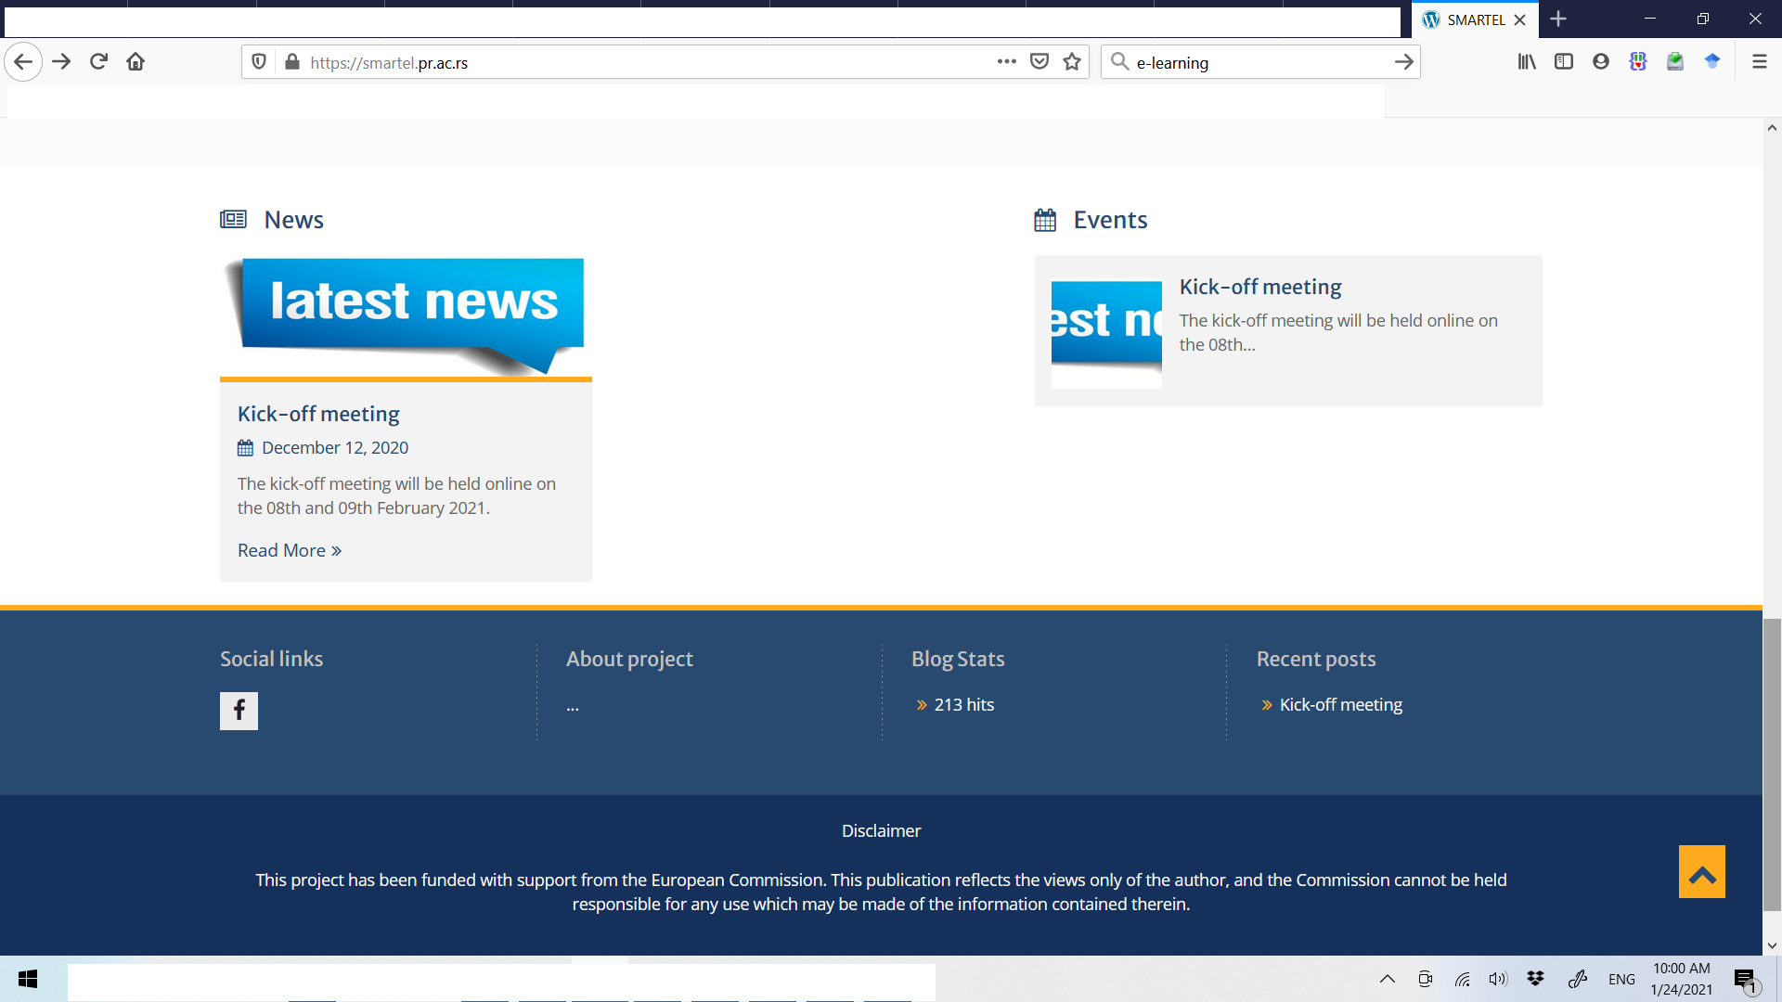
WWW.SMARTEL.PR.AC.RS
News and Events section

Slide 7
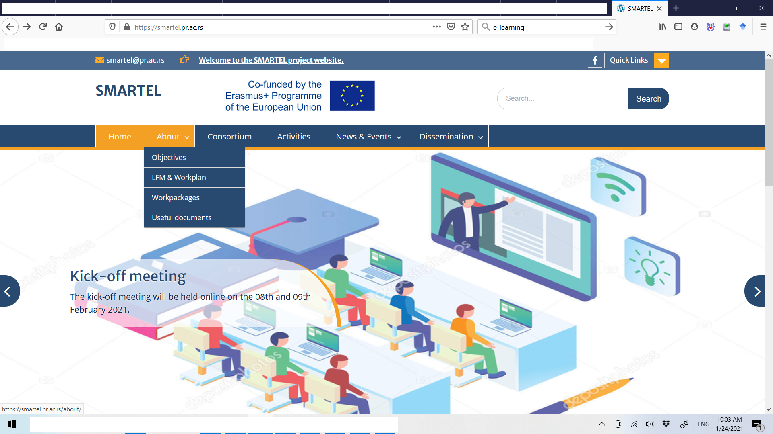
WWW.SMARTEL.PR.AC.RS
the drop-down menu for
the main project features

Slide 8
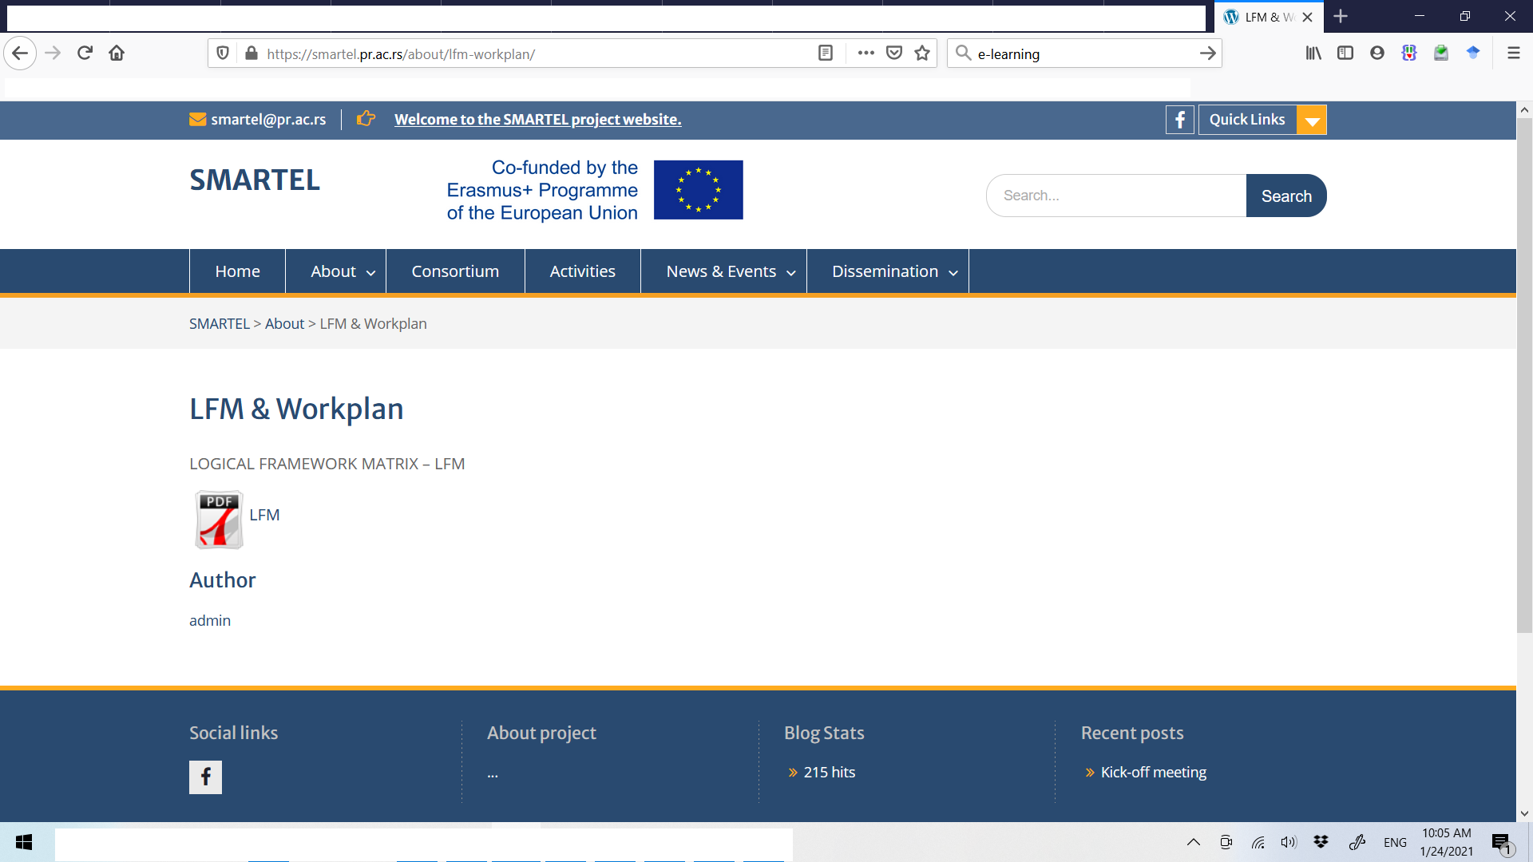
WWW.SMARTEL.PR.AC.RS
PROJECT
LFM & WORKPLAN
a .PDF files
to download

Slide 9
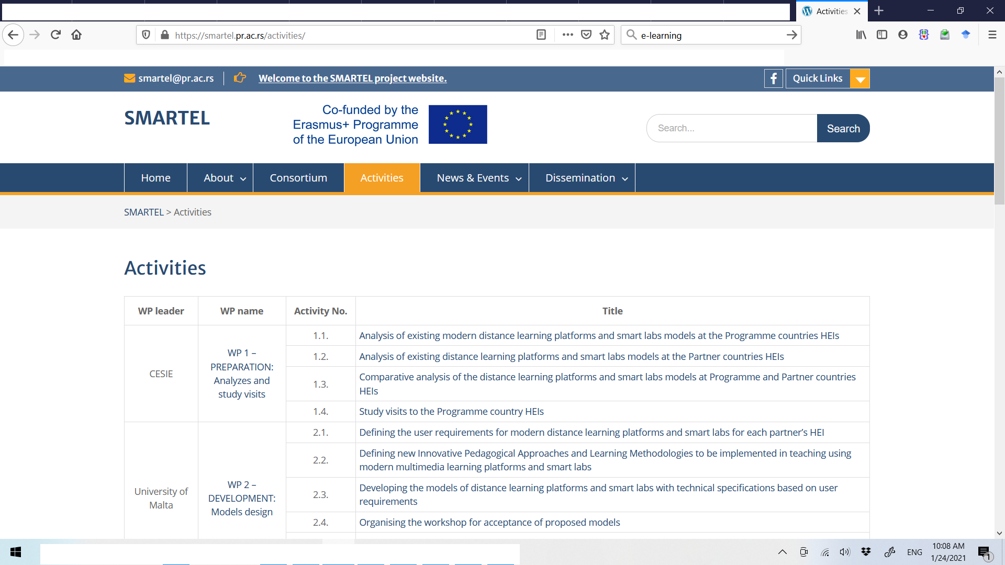
WWW.SMARTEL.PR.AC.RS
PROJECT
WORKPACKAGES AND ACTIVITIES
each
WORK PACKAGE and ACTIVITY
shortly explained with single click on it

Slide 10
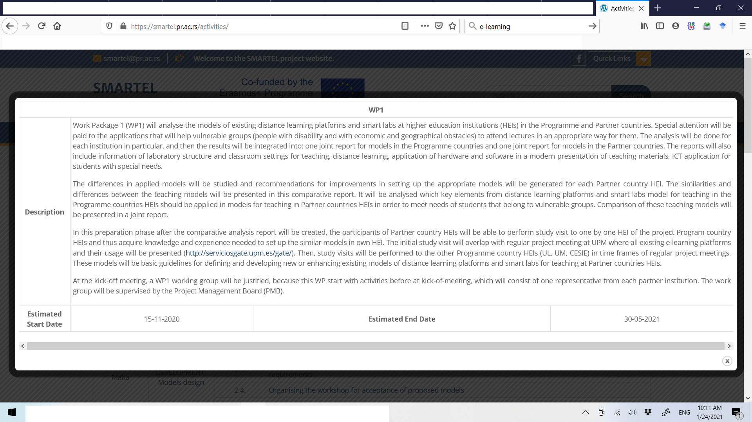
WWW.SMARTEL.PR.AC.RS
WORK PACKAGE short info

Slide 11
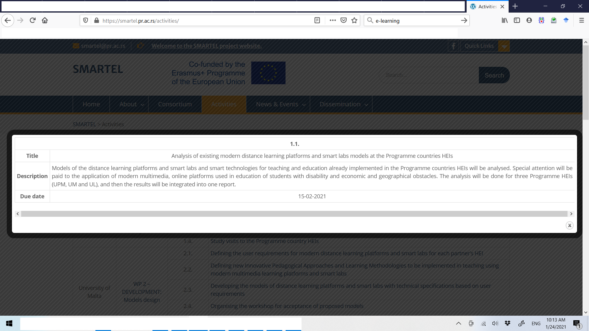
WWW.SMARTEL.PR.AC.RS
ACTIVITY short info

Slide 12
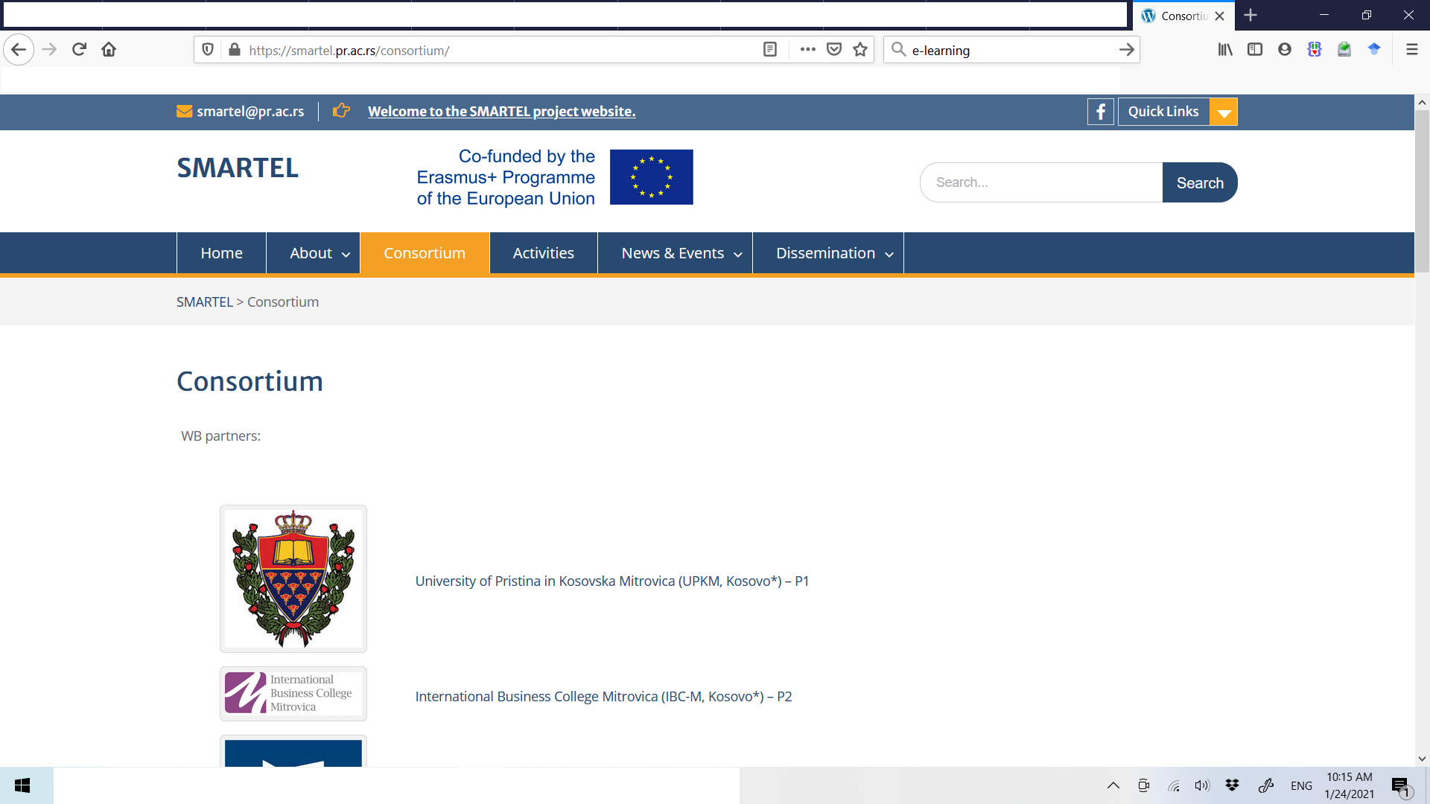
WWW.SMARTEL.PR.AC.RS
PROJECT
CONSORTIUM
each
CONSORTIUM MEMBER
shortly presented after
click on link

Slide 13
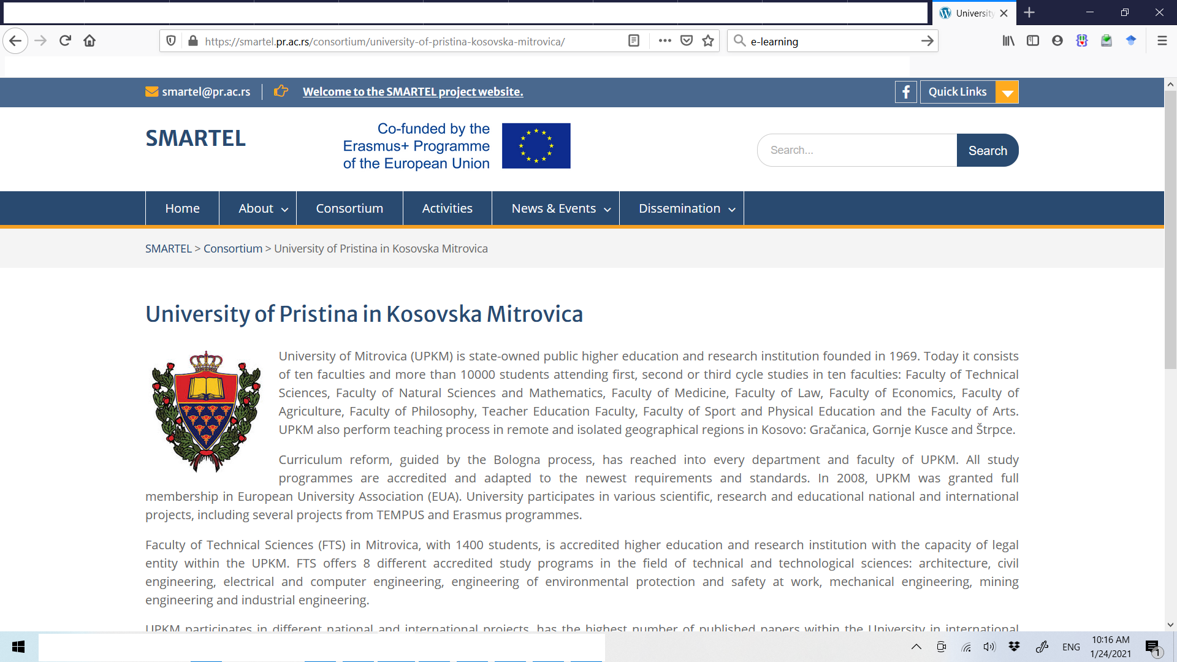
WWW.SMARTEL.PR.AC.RS
PROJECT
CONSORTIUM
each
CONSORTIUM MEMBER
shortly presented

Slide 14
WWW.SMARTEL.PR.AC.RS
PROJECT MANAGEMENT
an external link to a PROJECT MANAGEMENT PLATFORM
https://smartel.pr.ac.rs/admin

Slide 15
https://smartel.pr.ac.rs/admin
to manage
PROJECT FINANCE
to share internal FILES & REPORTS
to control project DEVELOPEMENT

Slide 16
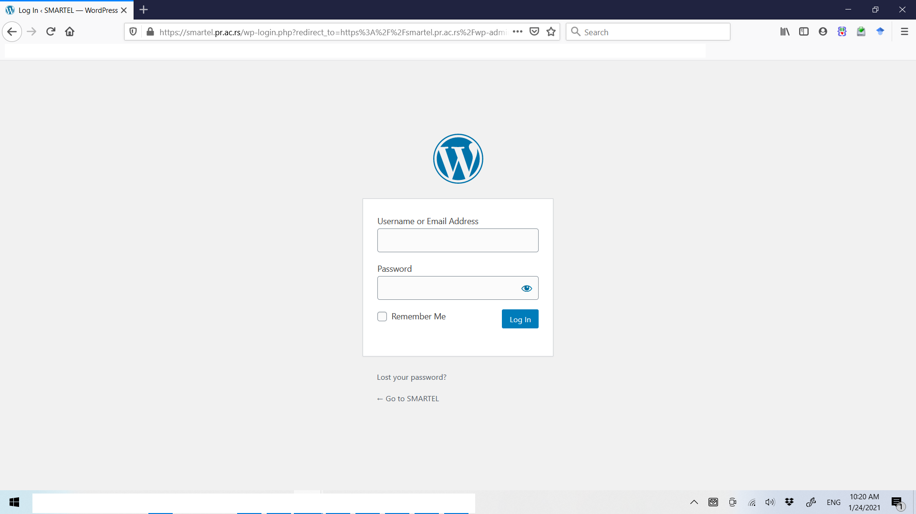
http://smartel.pr.ac.rs/admin
login username & password needed
access granted for each team member personally and by each institution

Slide 17
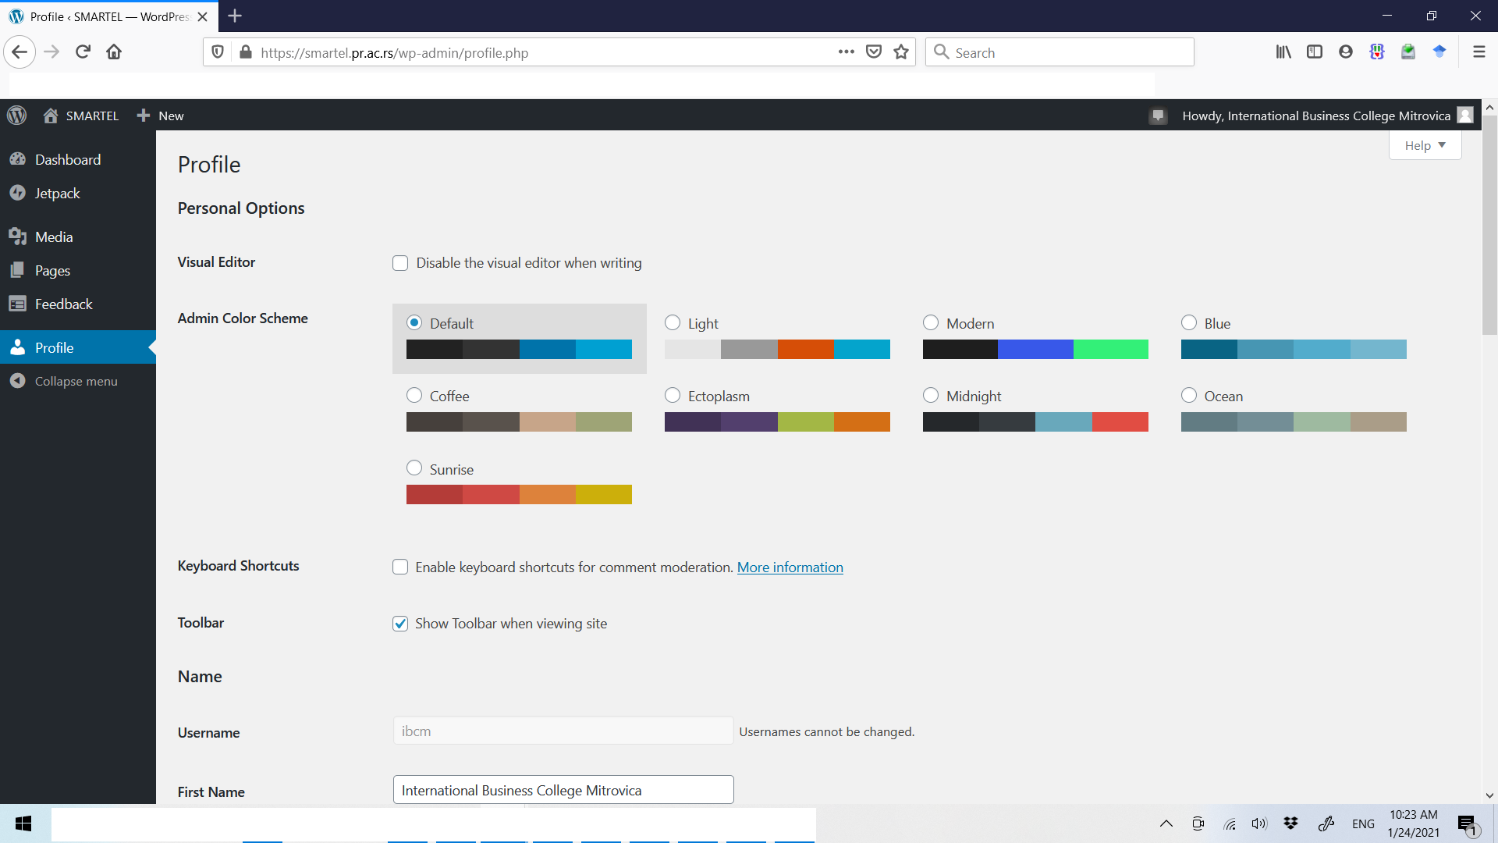
http://smartel.pr.ac.rs/admin
click here

Slide 18
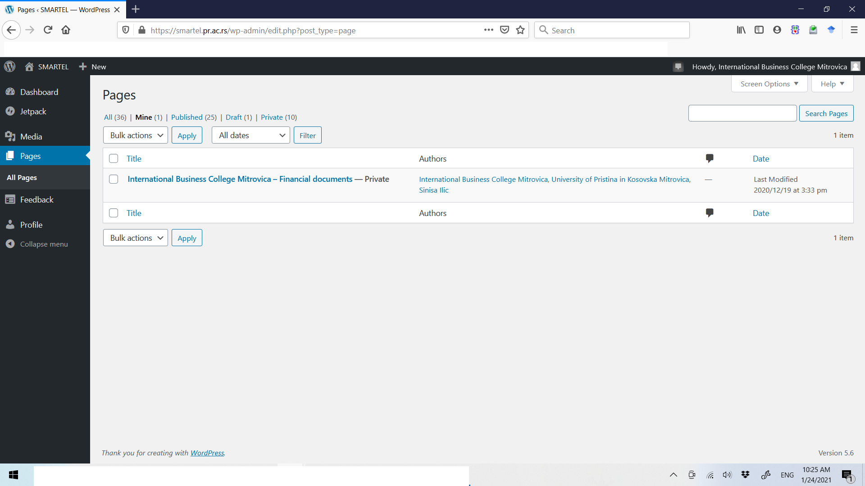
http://smartel.pr.ac.rs/admin

Slide 19
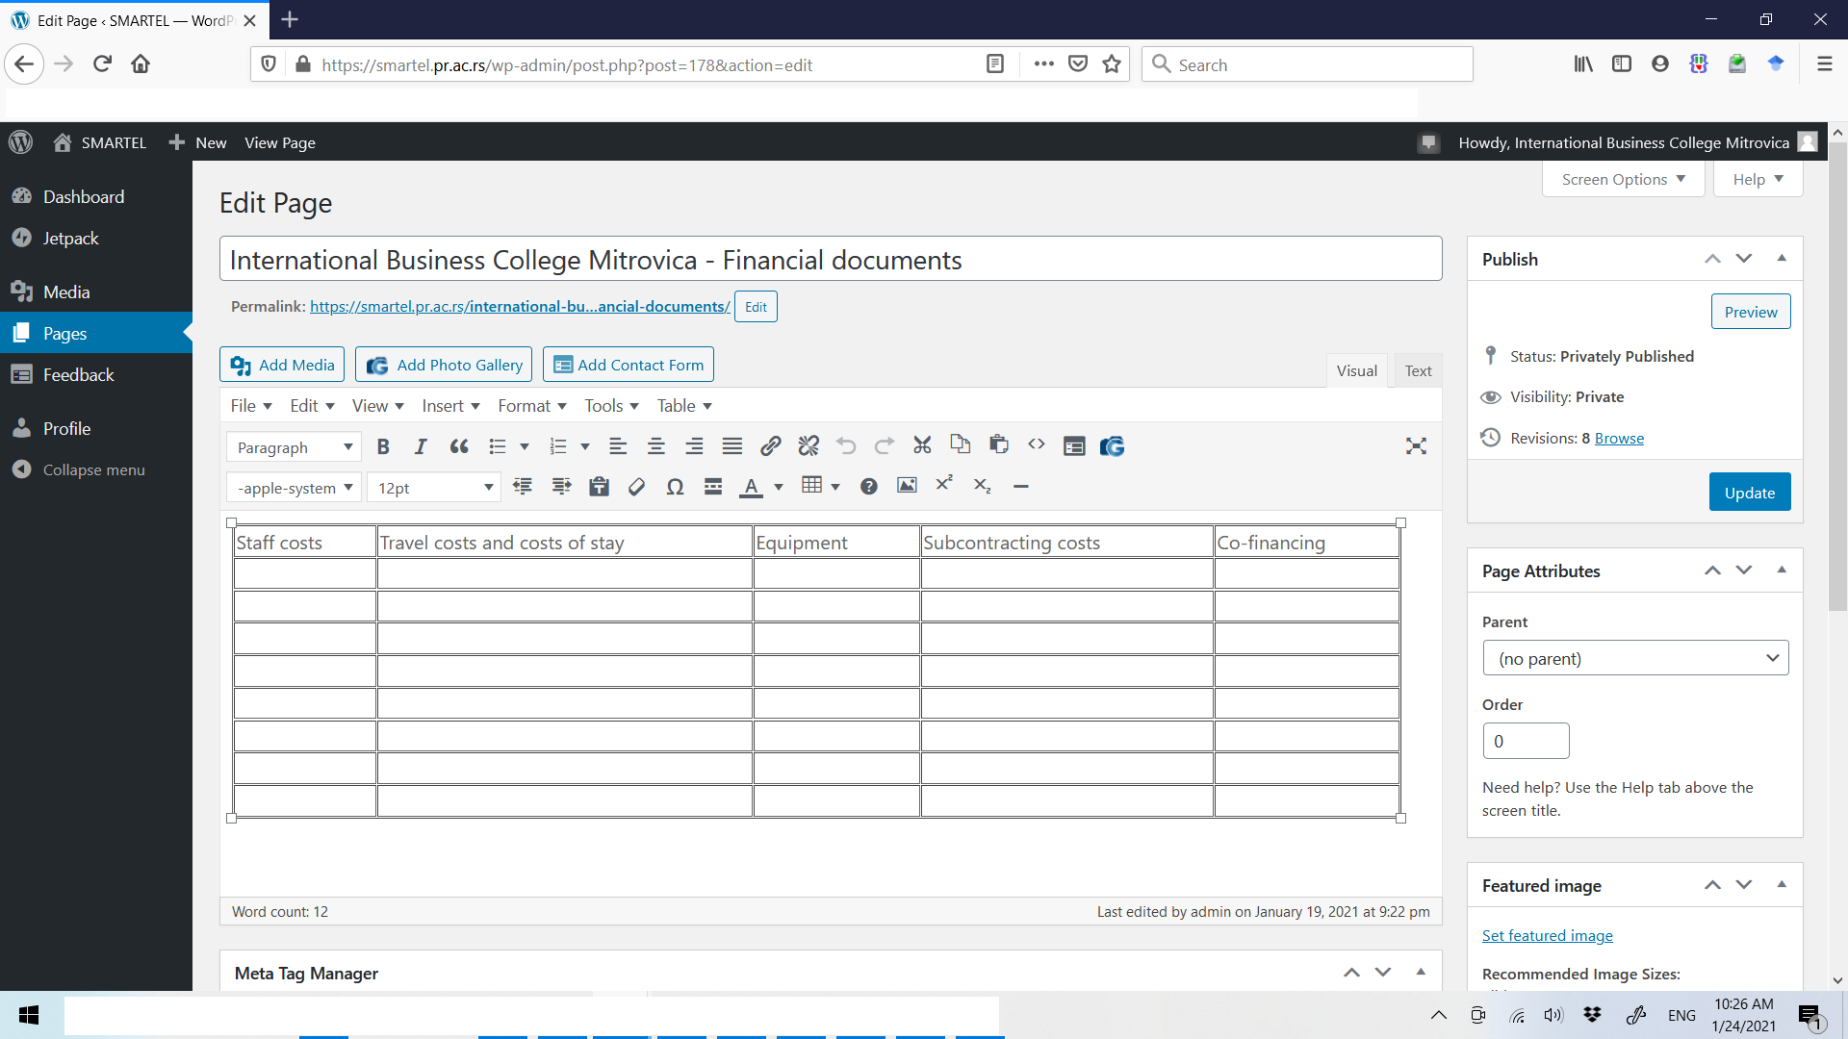
http://smartel.pr.ac.rs/admin
Click inside table cell, and enter document reference number

Slide 20
http://smartel.pr.ac.rs/admin
select it and click on Add Media button above

Slide 21
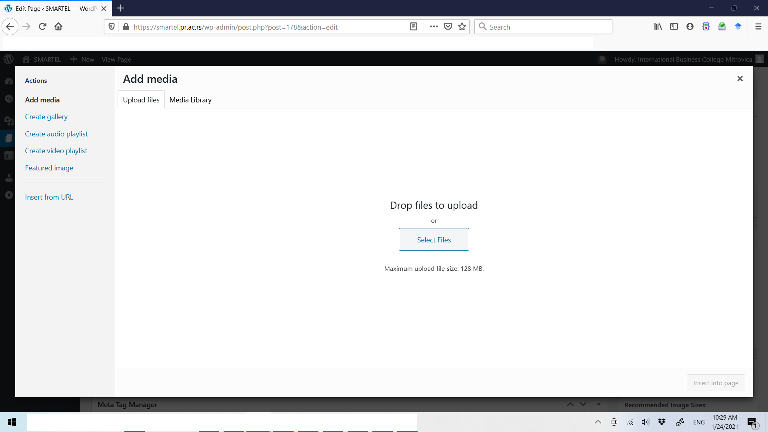
http://smartel.pr.ac.rs/admin
select file and upload

Slide 22
http://smartel.pr.ac.rs/admin
click here

Slide 23
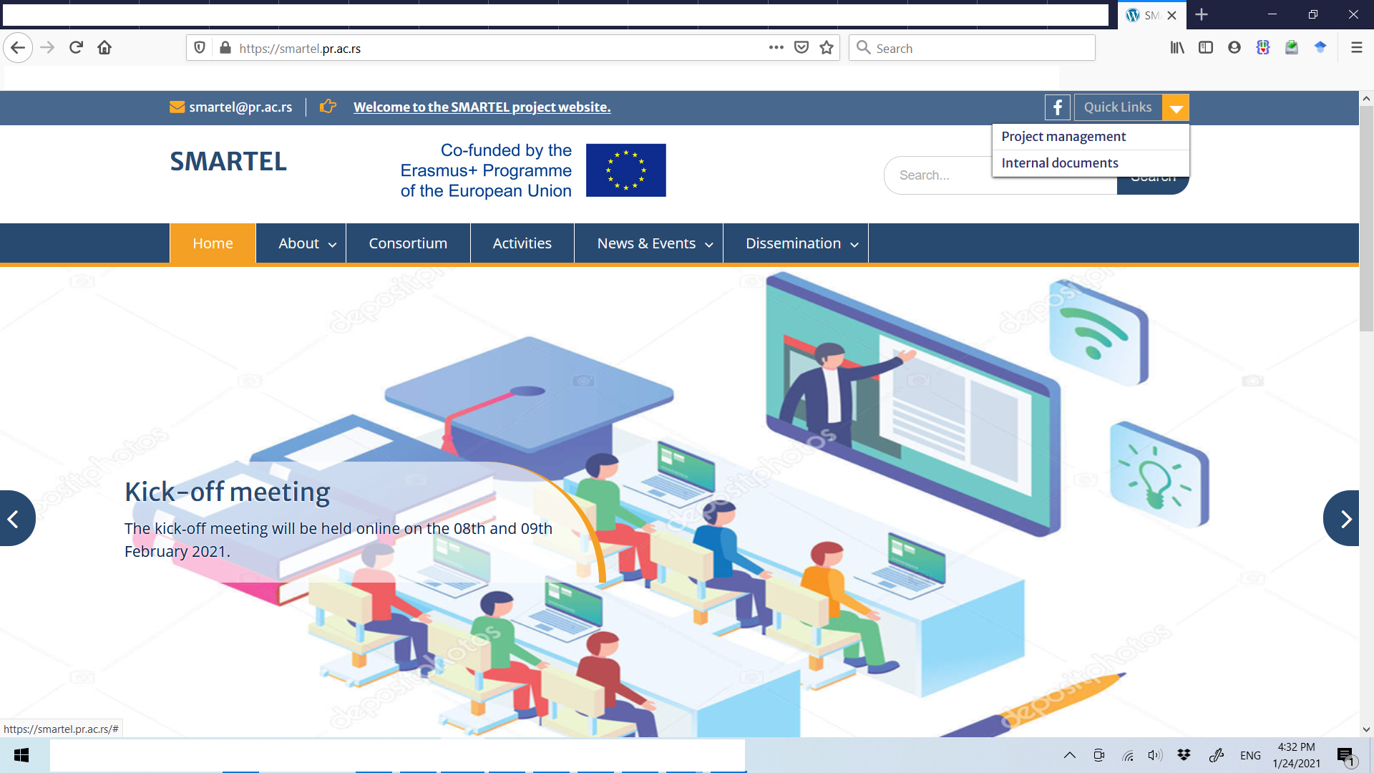
http://smartel.pr.ac.rs/admin
access to internal documents

Slide 24
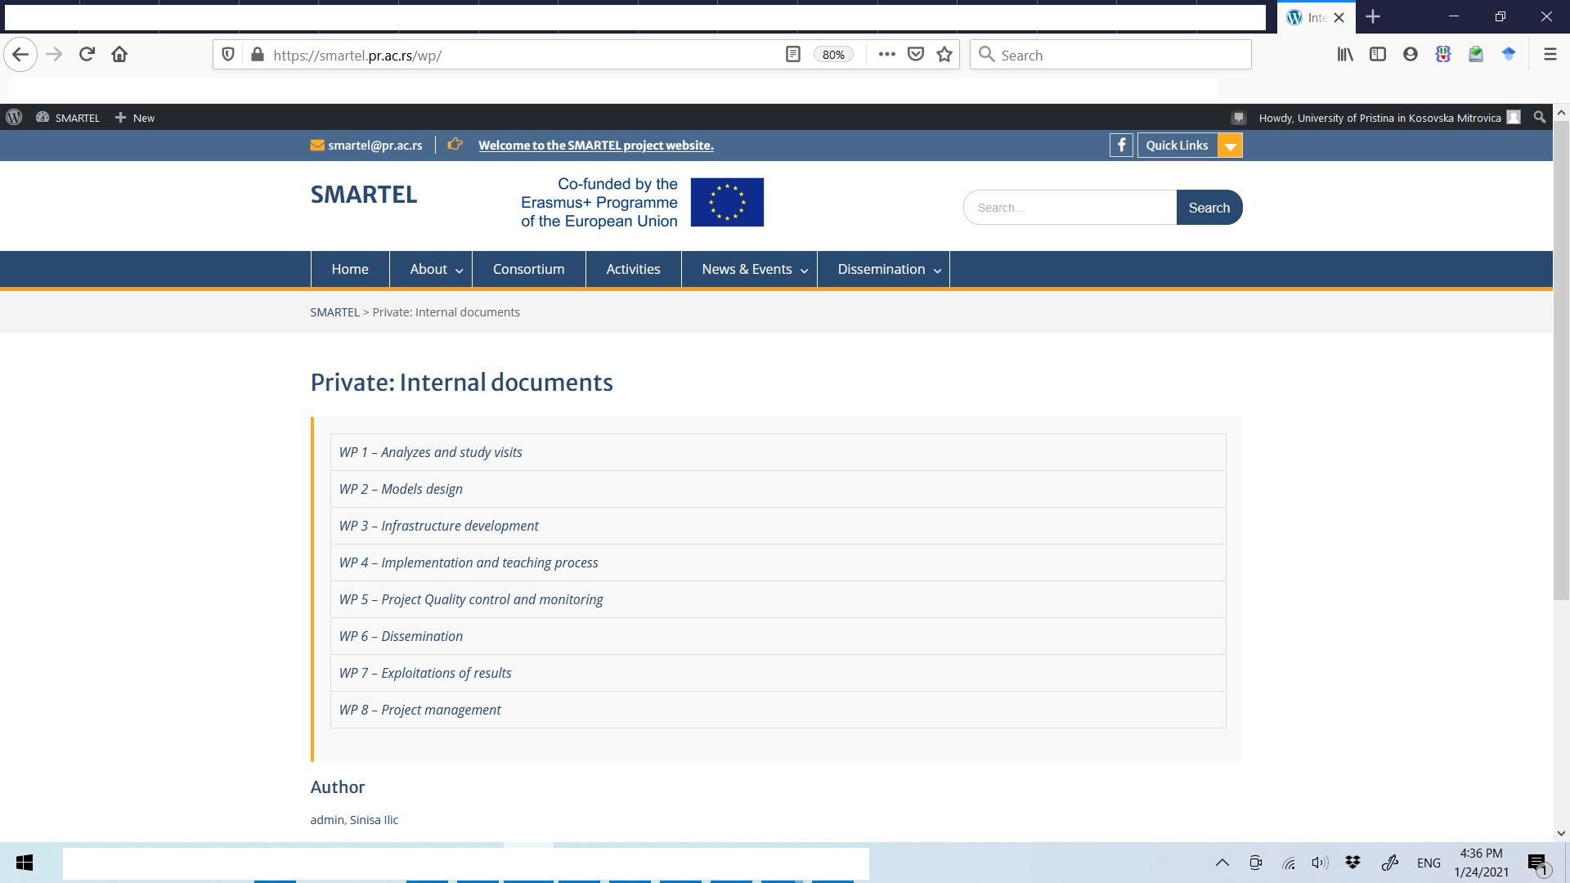
http://smartel.pr.ac.rs/wp

